Slide 1
Efficient and Automated Approach For Timetable Generation
PIP4004 University Project
Review-3
Batch Number: CSE-G128
Under the Supervision of,
Ms. Shet Reshma Prakash
Assistant Professor
School of Computer Science and Engineering
Presidency University
Roll Number | Student Name
20211CSE0385 | Tarun G.S
20211CSE0374 | Ravi Shivaji Mahipati
20221CSE0572 | V S Krishna Chaitanya Avvari
Name of the Program: CSE
Name of the HoD: Dr. Asif Mohammed H.B
Name of the Program Project Coordinator: Mr. Jerrin Joe Francis.
Name of the School Project Coordinators: Dr. Sampath A K / Dr. Abdul Khadar A / Mr. Md Ziaur Rahman

Slide 2
Content
Introduction
Literature Review
Proposed Method
Objectives
Methodology
Software Components
Timeline of the Project
Expected Outcomes
Algorithm & Pseudocode
Output
Conclusion
References

Slide 3
Introduction
The Automatic Timetable Generator is a software used to generate timetable automatically. Currently timetable is managed manually. It will help to manage all the periods automatically and also will be helpful for faculty to get timetable in their phone by using application. It will also manage timetable when any teacher is absent, late coming or early going. Maximum and minimum workload for a Faculty for a day, week and month will be specified for the efficient generation of timetable. By using this software users can apply for leave by providing leave required date, reason and also with substitute faculty. When selecting a faculty as substitute it allows to view timetable of that faculty for ensure that the faculty is free at that particular period. Substitute can approve or reject request. Principal can also view the request and send byfaculty and can also view substitute response. Principal can approve reject request. It is a comprehensive timetable management solutions for colleges which help to overcome the challenges in manually setting the timetable. By using thissoftware it will be very easy for faculty to get timetable in their phones.

Slide 4
LITERATURE REVIEW
SL.NO | TITLE OF THE PAPER/AUTHOR/PUBLISHER/YEAR | ADVANTAGES | LIMITATIONS
1 | Tavakkol, M., & Parsa, M. A Hybrid Genetic Algorithm for University Course Timetabling Problem Considering Faculty Preferences. Computers & Industrial Engineering, Volume 157, 2021, Article 107327. | The hybrid genetic algorithm enhances scheduling efficiency by incorporating faculty preferences. | It may require high computational resources for complex timetabling problems.
2 | Rong, Q., & Lee, K. Multi-Objective Optimization for University Timetabling Problem: A Comparative Study of Algorithms. Journal of Scheduling, Volume 25, Issue 1, 2022, Pages 57-72. | Multi-objective optimization algorithms provide flexibility to address diverse scheduling criteria. | They often require extensive fine-tuning for specific scenarios.

Slide 5
LITERATURE REVIEW(Contd..)
SL.NO | TITLE OF THE PAPER/AUTHOR/PUBLISHER/YEAR | ADVANTAGES | LIMITATIONS
3 | Hassan, M., & Khalil, M. An Intelligent Course Scheduling System Using Machine Learning Techniques. Journal of Educational Computing Research, Volume 61, Issue 3, 2023, Pages 445-465. | Machine learning techniques enable adaptive and automated course scheduling. | They depend heavily on large and accurate training datasets.
4 | Wang, X., & Xu, H. A Novel Memetic Algorithm for Solving University Timetabling Problems. Expert Systems with Applications, Volume 178, 2021, Article 115018. | Combines global and local search strategies for efficient timetabling optimization. | Memetic algorithms may require significant computational resources for complex problems.

Slide 6
LITERATURE REVIEW(Contd..)
SL.NO | TITLE OF THE PAPER/AUTHOR/PUBLISHER/YEAR | ADVANTAGES | LIMITATIONS
5 | Pillay, N., & Qu, R. An Evolutionary Algorithm for the Multi-Criteria University Timetabling Problem. Applied Soft Computing, Volume 115, 2022, Article 108163. | Effectively balances multiple criteria, such as faculty preferences and resource availability. | May require extensive parameter tuning for effective implementation.
6 | Nguyen, T. T., & Le, M. T. A Deep Reinforcement Learning-Based Approach for Automated Course Scheduling. IEEE Access, Volume 9, 2021, Pages 115765-115778. | Utilizes deep reinforcement learning to dynamically adapt and improve scheduling. | Requires large amounts of training data and computational power to achieve optimal results.

Slide 7
Proposed Method
The proposed method for the Automatic Timetable Generator involves developing a automates timetable creation and management by considering faculty availability, workload limits, and class requirements. It uses a constraint satisfaction approach with algorithms like Genetic or Greedy for optimal scheduling, ensuring no overlapping periods and balanced workloads. The system enables faculty to view timetables, apply for leave, and respond to substitute requests, while the principal can approve or reject leave and monitor schedules. A mobile app integration ensures real-time access for users, and the system automates updates for absentees or schedule changes, providing an efficient and scalable solution for timetable management.

Slide 8
Objectives
Automation of Timetable Creation: To automate the generation of timetables based on faculty availability, workload constraints, and class requirements, reducing manual effort.
Efficient Leave Management: To provide a system for faculty to apply for leave and manage substitute allocations seamlessly, ensuring minimal disruptions.
Improved Faculty Workload Distribution: To ensure fair and balanced workload distribution for faculty across days, weeks, and months.
Real-Time Accessibility: To enable faculty and administrators to access timetables and notifications in real-time through a mobile application.
User-Friendly Interface: To design a simple and intuitive interface for faculty and administrators to interact with the system effectively.
Scalability: To build a system that can handle large-scale data and adapt to the needs of multiple departments and institutions.

Slide 9
Methodology
The Automatic Timetable Generator involves designing a Python-based system that uses constraint satisfaction and optimization algorithms, such as Genetic or Greedy, to generate timetables based on faculty availability, workload limits, and class requirements. A centralized database stores all relevant data, including faculty schedules, class details, and leave requests, while a user-friendly interface allows faculty to view timetables, apply for leave, and manage substitutes. The system integrates mobile access for real-time updates and notifications and dynamically adjusts schedules to accommodate absences or changes, ensuring efficient and automated timetable management.

Slide 10
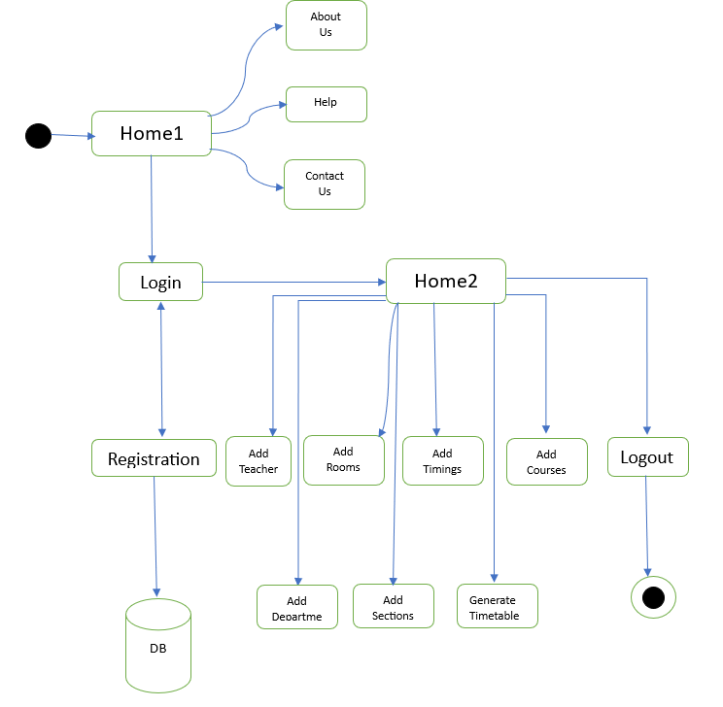
Architecture

Slide 11
Software Components
Technology Stack Components:
HTML
CSS
Python
Django
JavaScript
Database: sqlite3

Slide 12
Timeline of the Project
 | REVIEW - 0 |  |  |  | REVIEW - 1
 | 29-Jan-2025 To 31-Jan-2025 |  |  |  | 18-Feb-2025 To 21-Feb-2025
PLANNING
REQUIREMENT ANALYSIS
DESIGN
CODING
TESTING
DEPLOYMENT
PAPER PUBLICATION
REVIEW - 2 |  |  |  | REVIEW - 3
17-Mar-2025 To 21-Mar-2025 |  |  |  | 16-Apr-2025 To 19-Apr-2025
`
Final Viva-Voce
10-May-2025 To 17-May-2025

Slide 13
Expected Outcomes
Time Efficiency: Significant reduction in the time required to create and manage timetables.
Error Reduction: Elimination of manual errors in scheduling, such as overlapping periods or exceeding workload limits.
Improved Accessibility: Real-time access to timetables and notifications for faculty and administrators through a mobile application.
Balanced Workloads: Equitable distribution of teaching workloads among faculty members, ensuring compliance with specified limits.
Scalability and Adaptability: A scalable solution capable of handling larger institutions and adapting to evolving scheduling requirements.
User Satisfaction: Increased satisfaction among faculty and administrators due to the system's efficiency, reliability, and ease of use.

Slide 14
Algorithm
1. Start
2. Navigate to Home1
a. If the user selects About Us:
i. Display details about the system and its purpose.
b. If the user selects Help:
ii. Display a help page or FAQs related to system usage.
c. If the user selects Contact Us:
iii. Display contact details for technical support or system queries.
d. Allow navigation to the Login page.
3. Login Page
a. Accept user credentials (username and password).
b. Verify credentials with the database.
c. If valid:
i. Redirect to Home2.
d. Else, display "Invalid credentials".
4. Registration
a. If the user is new:
i. Accept registration details (name, email, password, etc.).
ii. Insert details into the database.
iii. Display "Registration successful".
5. Navigate to Home2
a. Add Teacher:
i. Accept teacher details (ID, name, department, etc.).
Validate and insert into the database.
b. Add Rooms:
i. Accept room details (room ID, name, capacity, etc.).
ii. Validate and insert into the database.
c. Add Timings:
i. Accept timing details (start time, end time, session type, etc.).
ii. Validate and insert into the database.
d. Add Courses:
i. Accept course details (course ID, name, semester, etc.).
ii. Validate and insert into the database.
e. Add Department:
i. Accept department details (department ID, name, head of department, etc.).
ii. Validate and insert into the database.
f. Add Sections:
i. Accept section details (section ID, course ID, etc.).
ii. Validate and insert into the database.
g. Generate Timetable:
i. Fetch teacher, room, course, and timing details from the database.
ii. Generate a timetable based on availability and constraints.
6. Logout
7. End

Slide 15
Pseudocode
Start
// Navigation to Home1
Display options: About Us, Help, Contact Us, Login
If User selects "About Us":
Display system details and its purpose
If User selects "Help":
Display help page or FAQs
If User selects "Contact Us":
Display contact details for technical support
If User selects "Login":
Navigate to Login Page
// Login Process
Accept username and password
Verify credentials with database
If valid:
Redirect to Home2
Else:
Display "Invalid credentials"
// Registration Process
Accept registration details (name, email, password, etc.)
Insert registration details into the database
Display "Registration successful"
// Navigate to Home2 (Post Login)
Display options: Add Teacher, Add Rooms, Add Timings, Add Courses, Add Department, Add Sections, Generate Timetable
If User selects "Add Teacher":
Accept teacher details (ID, name, department, etc.)
Validate details
Insert teacher details into database
If User selects "Add Rooms":
Accept room details (room ID, name, capacity, etc.)
Validate details
Insert room details into database
If User selects "Add Timings":
Accept timing details (start time, end time, session type, etc.)
Validate details
Insert timing details into database
If User selects "Add Courses":
Accept course details (course ID, name, semester, etc.)
Validate details
Insert course details into database

Slide 16
Pseudocode
If User selects "Add Department":
Accept department details (department ID, name, head of department, etc.)
Validate details
Insert department details into database
If User selects "Add Sections":
Accept section details (section ID, course ID, etc.)
Validate details
Insert section details into database
If User selects "Generate Timetable":
Fetch teacher, room, course, and timing details from the database
Generate timetable based on availability and constraints
// Logout Process
If User selects "Logout":
End session and return to Home1
End

Slide 17
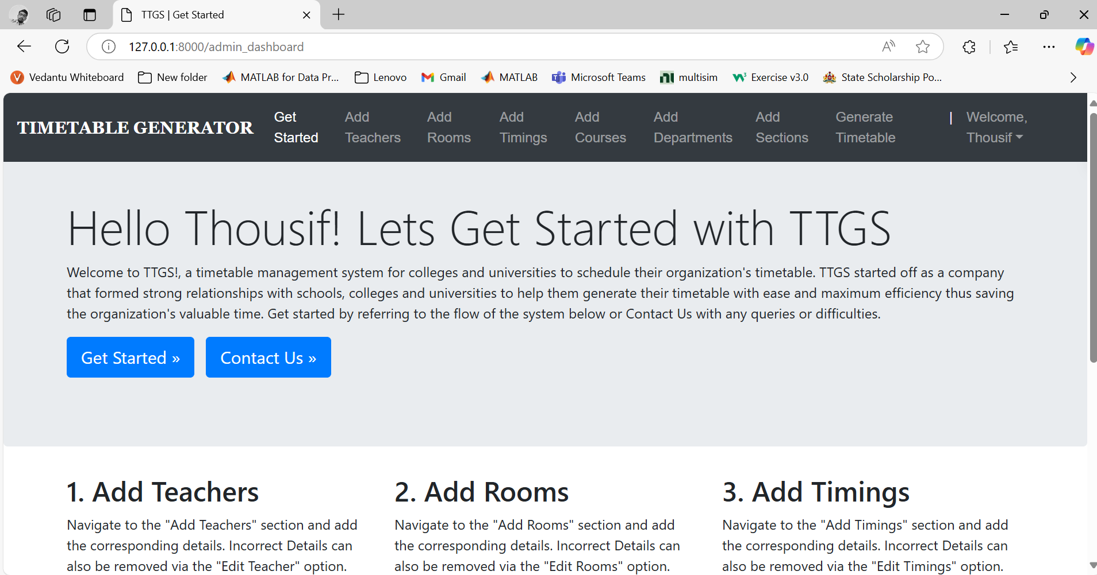
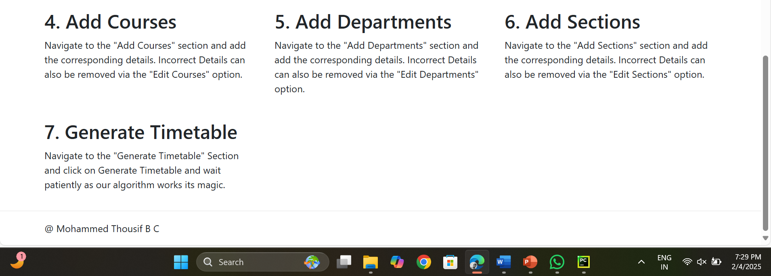
Output

Slide 18
Conclusion
The proposed work represents a genetic algorithm approach is very effective and useful on the lecture timetabling problems. Using the method we have described and shown a great potential for leading timetable in future which are fairer to students. The framework seems directly applicable to a very wide variety of other timetabling problem. For example, experimental result shows that a key aspect towards its success is the employment of the mutation operator described. The GA in timetabling framework has been shown to be successful on several real problem ‘University Department size‘, and so it seem we can justify the expectation for it to work very well on other problems of similar size and nature . That is, there is no reason to suspect that there is anything particularly easy about the problem it was tested on. In comparison to other real problems. Much works remain to do to see how performances scale to larger and otherwise different kinds of timetabling problems.

Slide 19
Github Link
The Github link provided should have public access permission.
GitHub Link : https://github.com/Tarun-G-S/Efficient-and-Automated-Approached-For-Timetable-Generation

Slide 20
References
[1]. Tavakkol, M., & Parsa, M. (2021). A Hybrid Genetic Algorithm for University Course Timetabling Problem Considering Faculty Preferences. Computers & Industrial Engineering, 157, 107327. [https://doi.org/10.1016/j.cie.2021.107327]
[2]. Rong, Q., & Lee, K. (2022). Multi-Objective Optimization for University Timetabling Problem: A Comparative Study of Algorithms. Journal of Scheduling, 25(1), 57-72. [https://doi.org/10.1007/s10951-021-00788-3]
[3]. Hassan, M., & Khalil, M. (2023). An Intelligent Course Scheduling System Using Machine Learning Techniques. Journal of Educational Computing Research, 61(3), 445-465. [https://doi.org/10.1177/07356331221122514]

Slide 21
References
[4]. Wang, X., & Xu, H. (2021). A Novel Memetic Algorithm for Solving University Timetabling Problems. Expert Systems with Applications, Volume 178, Article 115018. [https://doi.org/10.1016/j.eswa.2021.115018]
[5]. Pillay, N., & Qu, R. (2022). An Evolutionary Algorithm for the Multi-Criteria University Timetabling Problem. Applied Soft Computing, Volume 115, Article 108163. [https://doi.org/10.1016/j.asoc.2021.108163]
[6]. Nguyen, T. T., & Le, M. T. (2021).A Deep Reinforcement Learning-Based Approach for Automated Course Scheduling. IEEE Access, Volume 9, 2021, Pages 115765-115778. [https://doi.org/10.1109/ACCESS.2021.3106042]

Slide 22
Thank You

